Slide 1
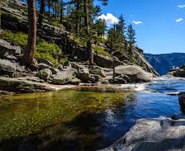
CURRENTS OF LIFE: RIVERS AS ECOSYSTEMS AND CULTURAL PATHWAYS
Creating interactive maps

Slide 2
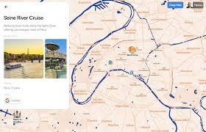
General steps for any tool
Choose the tool:
https://www.canva.com/
https://mapme.com/
https://www.pampam.city
https://maps.google.com
IT IS OPTIONAL

Slide 3

MAPME
This is a professional no-code platform used by businesses to create high-quality, interactive maps.
https://mapme.com/

Slide 4
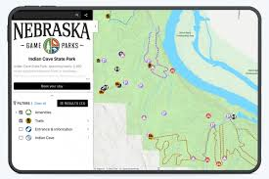
Best for
It can be used for estate tours, tour guides, university campuses, and event locations.
Key Features: You can add 3D views, videos, and images to locations. It is easy to embed on websites and works well on mobile devices.
Data: It often integrates with Google Maps but allows for much deeper customization of the user interface.

Slide 5

CANVA
Canva is an Australian online design and visual communication platform launched in 2013. It allows users to create a wide range of content—from social media graphics and presentations to videos and websites—using a simple drag-and-drop interface.
https://www.canva.com/

Slide 6
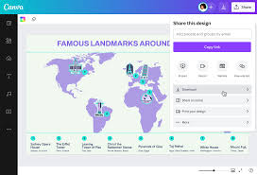
Key features and tools
Visual Suite: Create documents (Canva Docs), presentations, spreadsheets, and collaborative Whiteboards.
Templates: You have access to thousands of different templates to use. You can use only the free one to create waterbodies

Slide 7
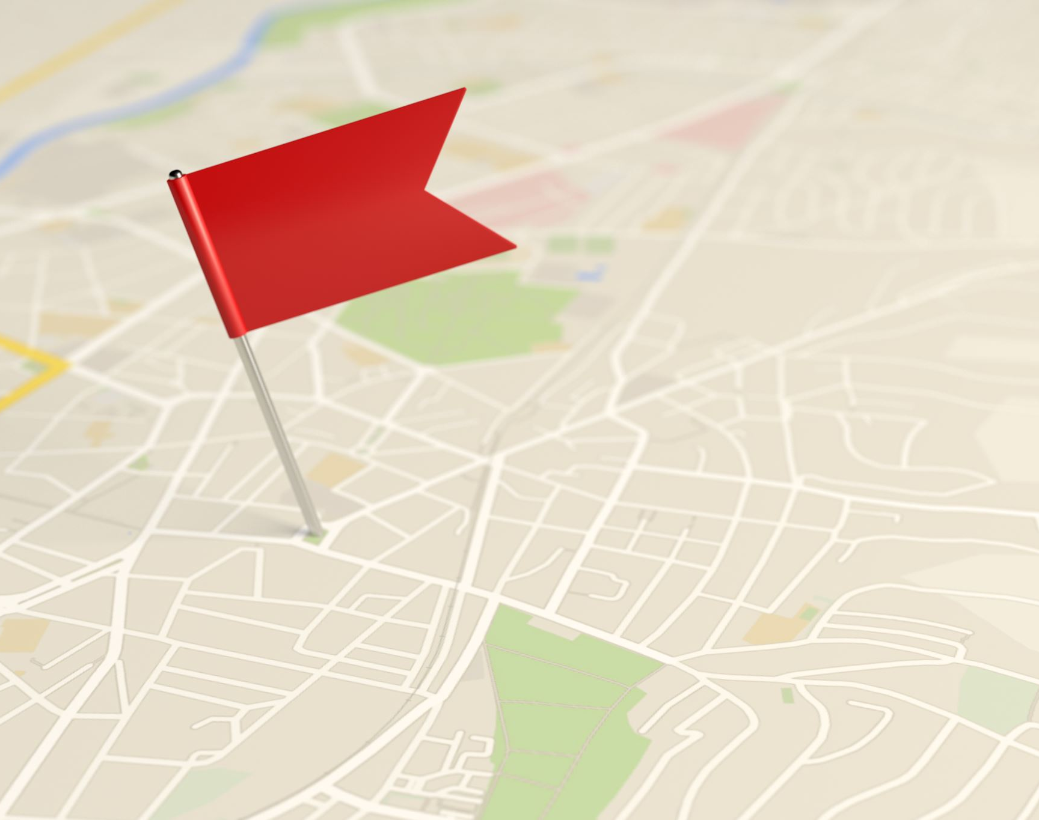
Google maps
https://maps.google.com
Google Maps is the world's most popular web-based mapping service, owned by Google. It provides detailed geographical information, satellite imagery, street views, and real-time navigation.

Slide 8
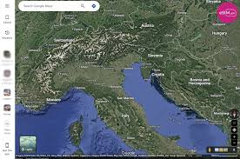
Key features
- Waterbodies creator: It can Mark all the different waterbodies and it can mark the mountains where they come from.

Slide 9

PAMPAM
PamPam (pampam.city) is a user-friendly tool designed to create interactive, aesthetic maps without needing any coding skills.
https://www.pampam.city

Slide 10
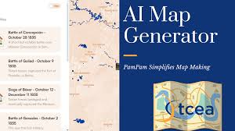
Standout features
- Social & Collaborative: You can invite others to add pins to a map, making it great for educational projects or field trips.
https://www.pampam.city/waterbodies-blagoevgrad-region-
https://www.pampam.city/UsuslqaFOOfDwfDewcOP?42.145355,26.511414,6.3

Slide 11
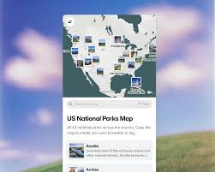
- Instant Data Import: One of its strongest features is the ability to turn Google Sheets, Notion pages, Airtable bases, or even a messy list of text into a structured map instantly.
Sticker & Brand Customization: Unlike the clinical look of Google Maps, PamPam allows you to use hand-drawn stickers, custom icons, and brand colors to make the map feel unique.
- PamCam (Video Export): It features a built-in tool that turns your static map into a smooth, animated video (MP4), which is perfect for sharing on social media stories or presentations.

Slide 12

Pricing Structure
Free: Includes unlimited maps with up to 30 places per map (includes PamPam branding).
Explorer ($5–$8/mo): Increases the limit to 150 places and removes watermarks from video exports.
Business ($20–$29/mo): Allows up to 1,000 places, website embedding, and access to Atlas AI (a chatbot that answers questions based on your map data).

Slide 13

AI Features
- Prompt to Map: Generate a map instantly by describing it (e.g., "bookstores in Paris" or "California road trip").
- Text to Map: Paste article text or captions, and the AI automatically extracts and maps the mentioned locations.
- Atlas AI (Beta): Available on Business plans, this feature turns your map into an AI-powered chatbot that users can interact with to ask specific questions about the mapped locations.

